Slide 1
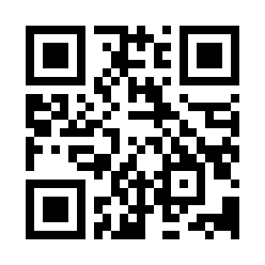
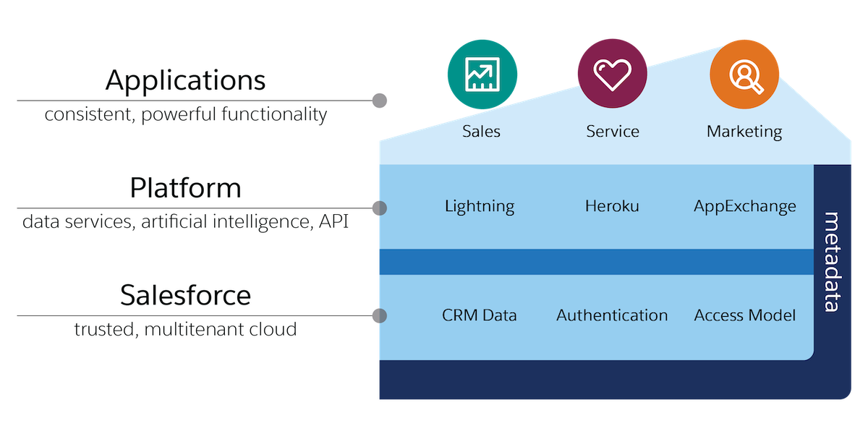
Salesforce Platform
https://bit.ly/3X0XriI

